Slide 1


Service Assurance Working Group
Developing ways to assure safety-related services
Since March 2017

Slide 2
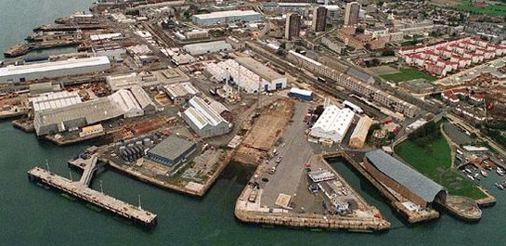


Services
Safety-related systems are
  built, installed, commissioned, operated, maintained and disposed of
  in a service context
Services rely on collaborative working of
  systems
  organisations
  people & processes

Slide 3
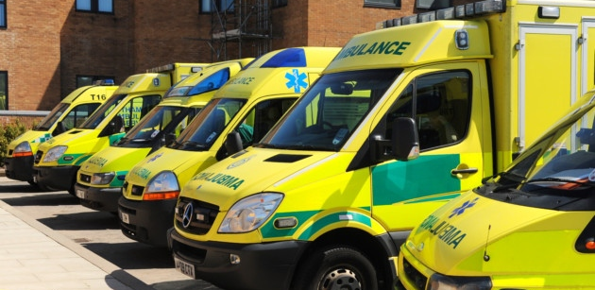

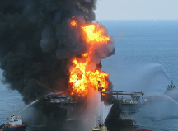
Service Assurance
Safety of a system can be compromised by poor service provision
A service-based approach aims to identify and manage issues that lead to poor service provision
  Enterprise risks and opportunities
  Inter-organisational and supply chain issues
  Emergent service behaviours

Slide 4
SAWG Aims & Achievements
Objectives
Produce clear and practical guidance on how services should be managed in a safety related context
Reflect emerging best practice
Numbers
36 Members
20 Meetings
Progress
Service Assurance Guidance v1
Papers presented at SSS’18, 19 & 20
Assessment of accident scenarios

Slide 5
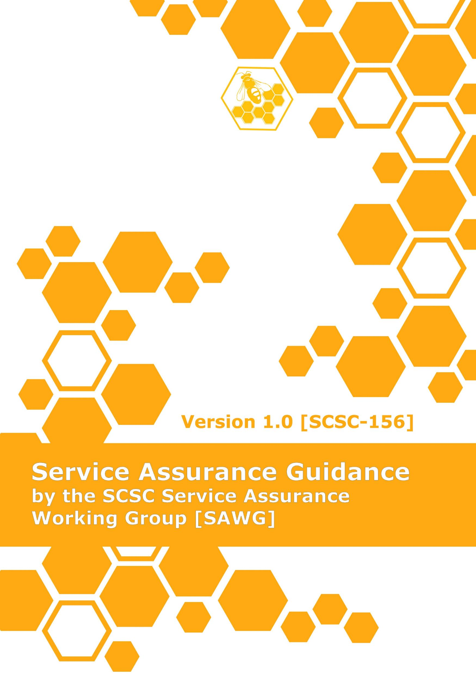
Guidance Document
Introduction
Assurance of Services
Principles and Objectives
Levels of Service Assurance
Managing Justifications and Evidence
Analysis Techniques
Service collapse, contingency and recovery
Real world examples of significant service failures
Further work
Notes:
Introduction
Provides rationale, i.e. why is this a problem now (industry trends, etc.). include case study examples across sectors.
Background aims and scope, target audience. Overall approach – not a standard but useful guidance in developing (domain specific) standards
Terms, definitions and glossary (in annex)
Services
Definition(s) of Service – addressing distinction from “systems” or “products”
Examples of services from different domains
Characteristics of Services - categorising degree of uniqueness compared to traditional “system” view. Need to stress that contracts which may be explicit or implicit. Note characteristics may not be complete or comprehensive – may need to be augmented for particular instance
Introduce (Reference) Service Based Solution Lifecycle. Perhaps based on contracting lifecycle, not design lifecycle
Principles
Statement and derivation of the 6 Assurance principles – including brief supporting description / explanation. Note changes to 1st and 6th principles: 1st reword and remove “System”; 6th change SBS to Service and delete everything after
(from DSIWG DSG) – Service Assurance Management Process? If so link to SBS Lifecycle
Objectives for each principle
Define a set of (assurance?) objectives to be met for each principle and/or each SBS Lifecycle phase
Describe context / explanation of each objective
Identify relationship between characteristics of services and objectives
Establishing the degree of robustness and confidence required in evidence to show objectives are met
Factors that influence assignment of LSAs, explaining why we don’t specify approach in the guidance (e.g. robustness or fidelity different for each sector)
Overview possible approaches e.g. use criteria (DO-178C style), ODR-style quiz (from Data Safety Guidance), or a “risk matrix” approach
Application of ALARP and risk sharing / delegation
Guidance on Demonstrating that Objectives are Satisfied
Service Assurance Levels
Discuss process for setting objectives against LSAs (e.g. which ones apply, at which level and in which circumstances)
Describe approaches used to address issues and unique characteristics of services
Tailoring - discuss issues around achieving sufficient confidence (proportionate to LSAs)
Capturing justifications and evidence
Use of Assurance Wrappers. MP: Covered in 6c. to some extent?
Types and nature of evidence (important to include possible extensions to the “allowable evidence base” to include things like commercial agreements, SLAs, etc. Also service management/reporting/surveillance data.
Satisfaction/Confidence during change, evolution and degraded (contingency) modes
How to assess evidence (if we have time…)
Supporting sections (Informative / Discursive)
Techniques
Service HI/HA/Swift etc. techniques to establish hazards of the Service. Also HAZOP Guidewords
Techniques to give assurance in order to meet LSA
Placeholder – service collapse, contingency and recovery
War stories [news, short summary with links]
Further work

Slide 6
Aims for 2020/21
Guidance material v2
Application and refinement of methodology
Worked examples for guidance
Exploring ties with Security methodology for SOAs
Interfacing with Enterprise Risk Assessment
Numbers
Active Members UP
Meetings UP

Slide 7

Contact
mike.parsons
@scsc.uk
SAWG
https://scsc.uk/gs
Next Meeting
London
24 March 2020
TBC
https://scsc.uk/e674

