Slide 1
Measuring safety culture – Practices and Pitfalls
Kathryn Mearns, Human and Organisational Factors Specialist, Jacobs

Slide 2
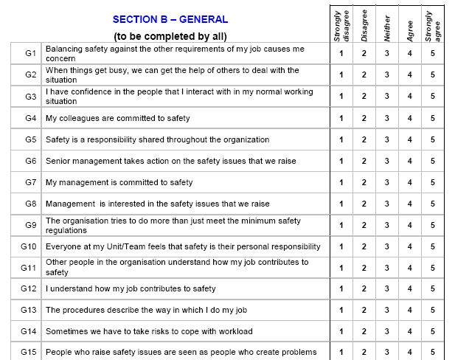
How do we measure Safety Culture?
Questionnaires
  Perceptions; attitudes
Observations
  Individual and group behaviour
Interviews
  Values, beliefs, knowledge, understanding
Focus Groups
  Group interaction, challenges,
  Use a combination of techniques to address:
  Artefacts
  Espoused Values
  Basic Assumptions
  identifying improvements

Slide 3
Self-Administered Questionnaire surveys
Questionnaire design
  Developing own questionnaire?
  Using pre-developed questionnaire?
  Layout and sequence of questions?
  Mix of open questions and closed questions?
  Single versus multiple responses?
  Ranked responses?
  Rated responses, e.g. Likert scale?
  Question wording
    Be concise and unambiguous
    Avoid double questions
    Avoid questions involving negatives – there is a debate about this in the literature
    Ask for precise answers
    Avoid leading questions
  Confidentiality and Ethics

Slide 4
Self-Administered Questionnaire Surveys
Survey administration
  On-line or paper-based – advantages/disadvantages of each
Sampling procedure
  Cross-section of workforce, whole organisation
Analysing data
  Percentage of respondents replying to response options
  Other data analysis methods
Producing reports
  Format
  Level of detail
Feedback to interested parties
  Presentations - workgroups; management
Develop and implement Action Plans from the output of the survey

Slide 5
Focus Groups and Interviews
Preparation
Location of interview
Timing of interview
Interview structure including scene setting
Questioning techniques
Recording/note taking
Group and Individual interviewing

Slide 6
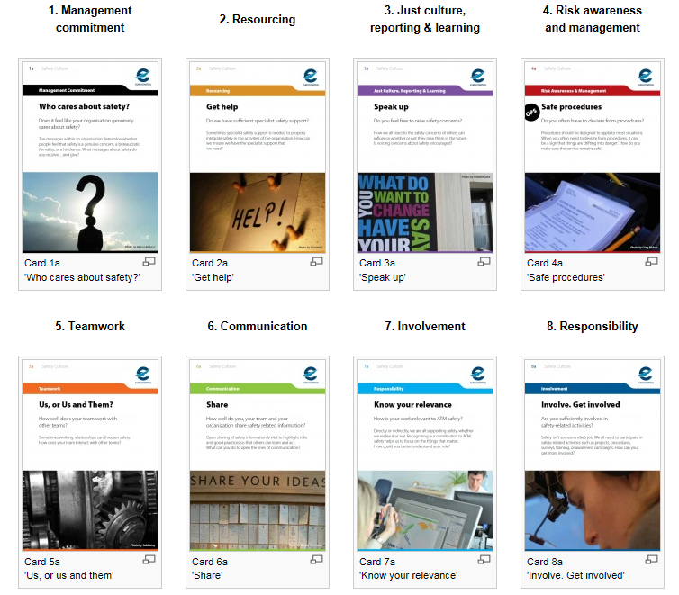
Sort Cards (EUROCONTROL)
Aimed at ownership, discussion, reflection rather than measurement
    Engage
    Educate
    Flexible Use
    Reinforce memory
    Linked to theory
    Improve safety culture
    Comparing views
    Safety moments
    Focusing on one element
    SWOT analysis
    Influences on each other
Notes:
Engage: tool for any individual or group to promote ownership and discussion.
Educate: Enhance and build on existing understanding of safety culture from users’ experience. Cards do not give answers, but raise questions for discussion.
Enable flexible use: Several possible ‘games’ for the cards. Five possibilities are described, but users may use the cards however they wish. The cards are physical artefacts, but may also be used digitally, e.g. on smartphones.
Reinforce memory: Headlines and pictures designed to be memorable so that users can recognise aspects of the cards when they are not using them.
Link to theory: Tool for discussion and reflection rather than measurement. Based on model of safety culture and represent issues from theory and around 20 ANSP surveys. The cards bridge the gap between research and practice.
Improve safety culture: Help users to think of ways to improve safety culture – and inspire them to take action based on the results
Comparing views: Sorting cards into: ‘What we do well’ & ‘What we need to improve’, then compare and discuss the piles and discuss.
Safety moments: Small group discusses one card for 10-15 minutes, taking brief notes of any actions arising from the discussion.
Focus on a specific element and discuss each card in depth. Sort cards or consider: What do we do well? What and where is our ‘best practice’ on this issue? Where do we need to improve?
SWOT analysis: Sort the cards into strengths, weaknesses, opportunities and threats, and discuss the results.
Influences: Organise cards into patterns to show how the issues relate to one another, e.g. cause-effect relationships, or may influence each other in a more subtle way. How do these relationships work in the team, unit, ANSP, etc?

Slide 7
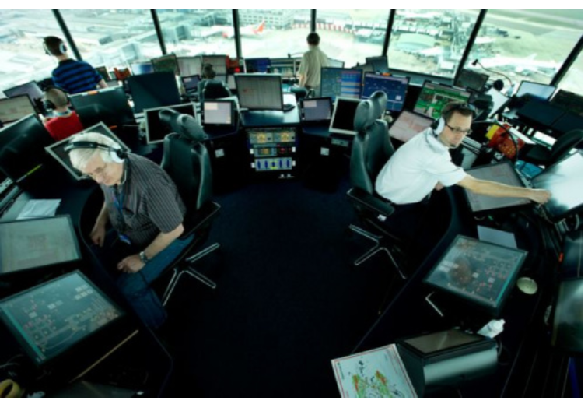
EUROCONTROL Air Traffic Control Safety Culture Elements
Management Commitment to Safety
Resourcing
Just culture, reporting and learning
Risk awareness and management
Teamwork
Communication
Involvement
Responsibility

Slide 8

Offshore Oil and Gas Industry Safety Climate Factors (Mearns et al., 1997)
Management Commitment to Safety
Supervisor Commitment to Safety
Incident Reporting
Communication
Workforce Involvement
Work pressure (perceived)

Slide 9

Categories and Traits of Nuclear Safety Culture (INPO/ WANO, 2013)
Management Commitment to Safety
    Leadership Accountability
    Decision-Making
    Respectful Working Environment
Management Systems
    Continuous Learning
    Environment for Raising Concerns
    Work Processes
    Problem Identification and Resolution
Individual Commitment to Safety
    Personal Accountability
    Effective Safety Communication
    Questioning Attitude

Slide 10
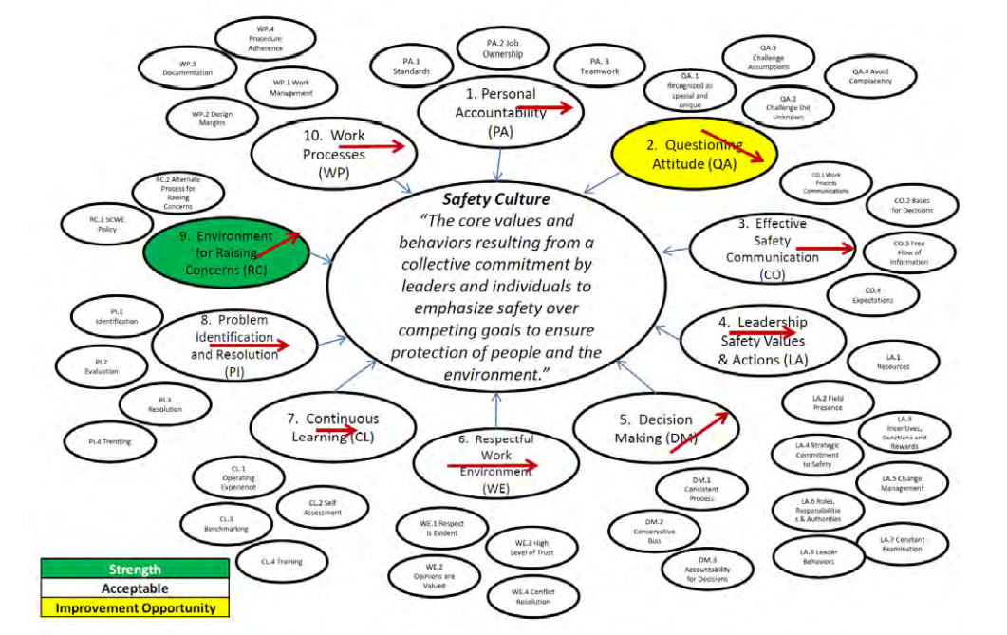
Institute of Nuclear Power Operations. Nuclear Safety Culture. Industry Best Practices. INPO 20-004. August 2020
The Leader’s Role in Nuclear Safety Culture
Nuclear Safety Culture Best Practices
Organizational Effectiveness Road Map
  How to Use it for Assessments
‘Binning’ Nuclear Safety Culture Traits
Nuclear Safety Culture ‘Bubble Chart’
Nuclear Safety Culture Analysis Tool
Utility Nuclear Safety Culture Scorecard
Nuclear Safety Culture Forward Focus Guidance
Nuclear Safety Culture Surveys
    Comprehensive NSC questions
    Abbreviated NSC questions
Nuclear Safety Culture Circular Model
Nuclear Safety Culture References

Slide 11
Safety Culture Assessments – Main issues emerging
Communication
  Too much, too little, not relevant
Procedures
  Unworkable, out-of-date, managers and engineers fail to understand difference between work-as-imagined in the office versus work-as-done on the front-line
Continuous Learning
  Failure to implement lessons learned; failure to ensure workforce is fully trained and competent
Visibility of management
  Never see them; do not implement actions in a timely way; mismatch between what they say and what they expect people to do
Employee engagement
  No one ever asks us our opinion; if we do voice opinions no one listens to us

Slide 12
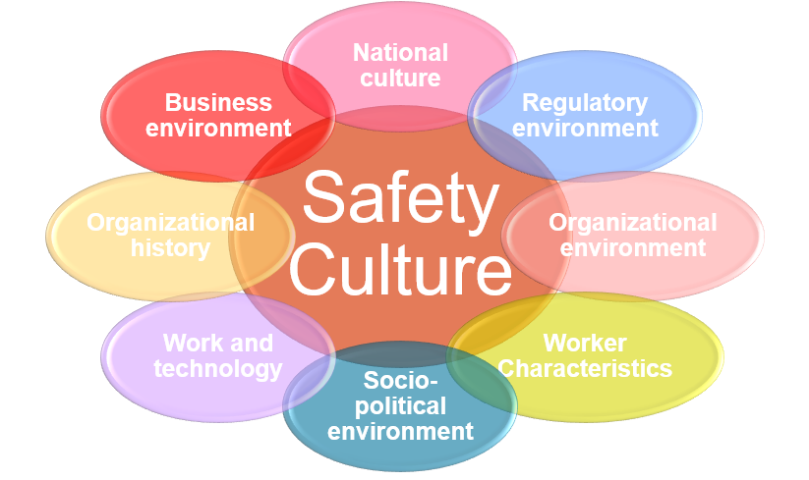
External Influences on Safety Culture
Tends to be forgotten
Socio-technical systems theory
  ‘Open’ systems
National culture and safety
  Hofstede Value Survey Module (VSM)
    VSM scale reliability dubious
  Safety culture measures
  Safety behaviour
  Occupational accidents
Studies inconclusive
  Oil and gas industry
  Air Traffic Control
  Manufacturing

Slide 13
John Carroll - MIT
Institutionalise surveys and dialogues with workers
Establish criteria for culture performance
  This has proved challenging for most organizations
  Is it possible to establish cultural criteria?
The survey itself is almost irrelevant, it’s the conversations around a survey and the actions based on those conversations that are important

Slide 14
The challenges of safety culture
Telling leadership and management what is wrong
No action being taken
Lack of management integrity
Disappointed workforce
Erosion of trust
Safety culture becomes ‘lip service’, ‘tick-box exercise’ (literally!) and not taken seriously in the future
Nothing changes
Organisational safety continues to be comprised

Slide 15
Quote attributed to Edgar Schein (from David Collins, Jan 2010)
Good management produces safety
When there are safety problems it usually means bad management somewhere in the system
At some point the safety assessors (internal and external regulation) have to be prepared to call the problem what it is:
  Senior executives who care more about finances than safety
  Middle managers who care more about productivity because that is what senior managers reward them for
  Supervisors who suppress employee complaints and efforts to identify safety problems because it takes too much time to look into things and to convince their bosses about critical maintenance issues that may be surfacing.
What makes safety culture so complicated is that we are trying to build safety into badly managed companies!! (Edgar Schein)

Slide 16
Conclusions
Organisations like to look for ‘quick fixes’ as far as safety is concerned
  Focus tends to be on lagging indicators such as ‘lost time injuries’ and making sure that ‘front-line workers’ are ‘behaving’ as they should
  Less focus on Systemic issues and the socio-technical approach
Measuring ‘Safety Culture’ should involve domain experts (HOF Specialists) and not simply depend on quantitative ‘questionnaire surveys’
Safety culture requires deeper, more probing, qualitative approaches, e.g. interviews, focus groups, document analysis, field observations
If done properly, measuring safety culture should address Systemic issues
  Two key issues to get right; Management Commitment and Employee Engagement
Use safety culture assessments to measure what goes right as well as what goes wrong
  Benchmarking (with care!) both within and between organisations

Slide 17
End of presentation
Questions?

